Slide 1
Video&Audio Conferencing Application

Slide 2
Implementation Details
Language: C#.net.
Tool: MS .Net 2005 IDE.
Application type: Windows application.
Prerequisites: MS .netFramework2.
Under Supervision of:
      Dr.Khaled Hussien
Implemented By:
      Ali Hussien Ahmed.
      Sec 2

Slide 3
Project Description
A socket based application that is used to transmit live video and audio-which can also called Voice over IP between multiple computers connected together via LAN.
Project is developed to run between multiple hosts, a Server and many Clients, all must own the capturing devices the Webcam and Microphone.

Slide 4
Details
Application can be divided into six steps
Capturing Data.
This is what we concern in our course, how to capture frames from camera, how to display it in the local computer view and send it, this is quit different from audio continuous data the decision is where&when to “cut” is quit difficult.

Slide 5
Compressing Data.
Needed to save network bandwidth and reduce traffic, but unfortunately this step will be skipped as we don’t know image compression techniques that is used to compress video frames.

Slide 6
Sending Data.
This is the easiest process because standards will help me, as known video and audio data is transmitted over UDP/IP Protocols, because of the fast transmission speed, free of redundant control bits (TCP) and lost tolerance.

Slide 7
Receiving Data.
Raw bytes are received and processed and next to...
Decompression.
If a compression technique was used.
Presentation.
In case of sound bytes to the sound card directly (waveOutOpen…) To the Speaker.
In case of video bytes → frame by frame displayed in a picture box with high speed rate.

Slide 8
Application Architecture
I’ve used Standard Client/server model ,multiple clients are logically interact together as “Peers” but actually all their activities are processed by single Server.
Server has a full control and monitor on the clients connected.

Slide 9
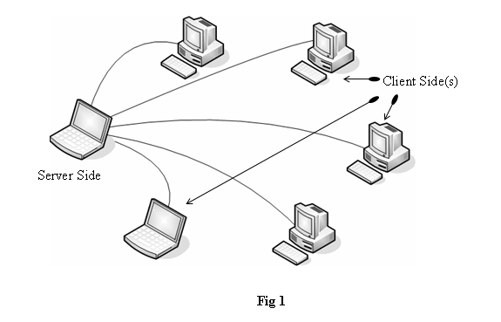
Interaction with Application

Slide 10
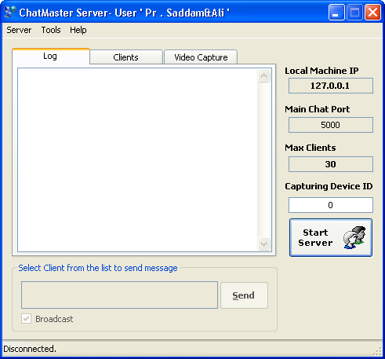
Server Idle State
Press “Start Server” to run the application

Slide 11
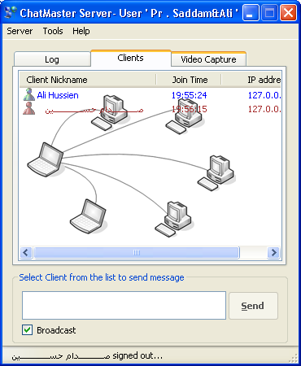
Server-Clients Tap
Connected clients are kept, and their join time are recorded ,so their IP’s and status.
Online
Offline
Text messages written here

Slide 12
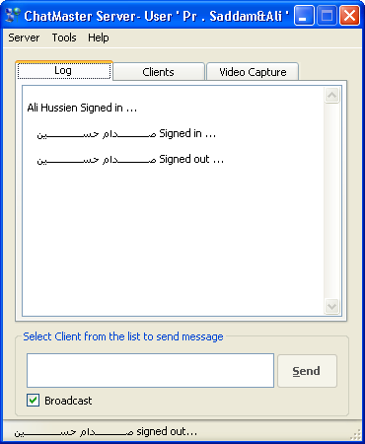
Server-Log tap
Clients actions and activities are recorded.
also Text messages are written here

Slide 13
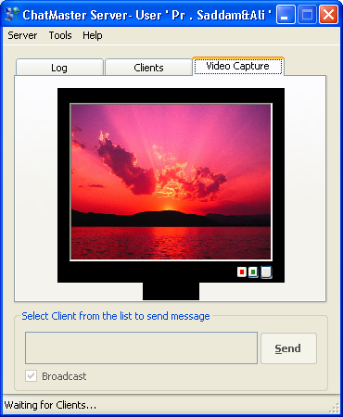
Server-Video Capture tap
Which displays server side pictures
For sending test
Start capture
Stop Capture

Slide 14
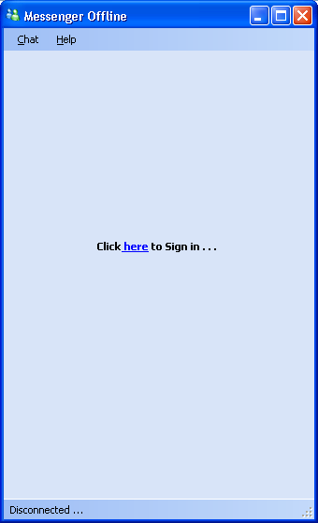
Client
Offline view

Slide 15
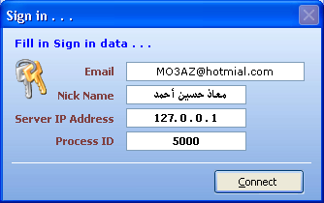
Login view

Slide 16
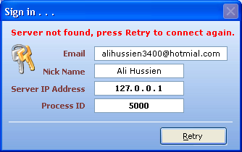
Login Failure

Slide 17
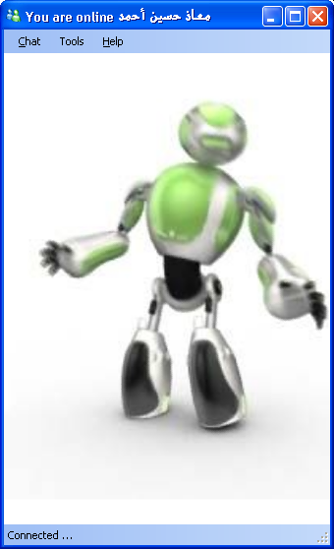
Login Successful
ShockWave Flash Object

Slide 18
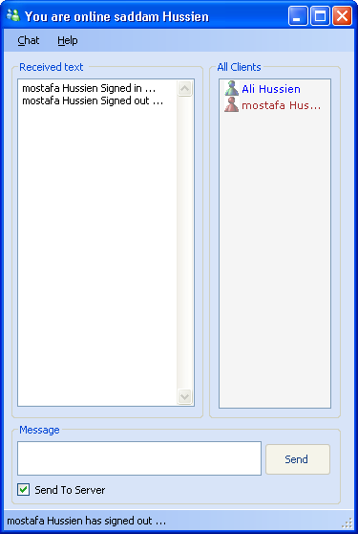
Active View
Friends

Slide 19
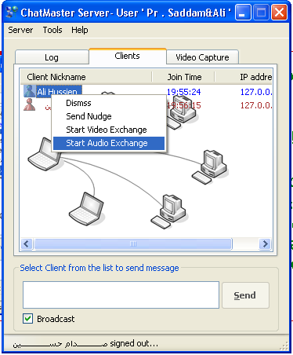
Start audio Chat
full duplex audio chat .
Stereo, very clear Sound !!!.
Server and client initiated.
Begin sound exchange between server and the selected client.

Slide 20
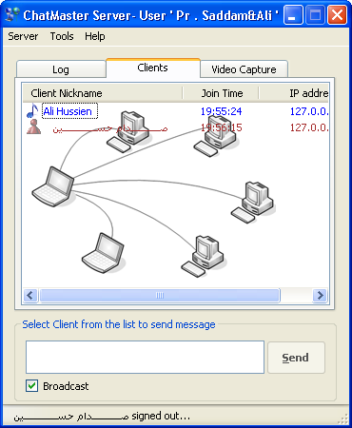
Audio Exchange
Audio Exchanging already running with “Ali Hussien”

Slide 21
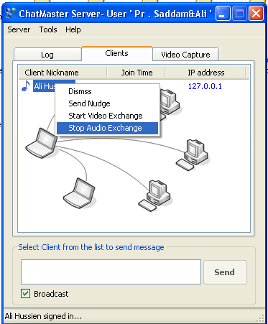
Stop audio Chat
Just Select “Stop”

Slide 22
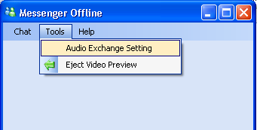
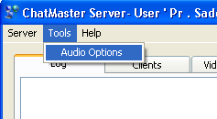
Audio Customization
“Expert Users ” and server side can adjust audio received or sent audio streams attributes from “tools>audio exchange setting”.
But “playing” in those attributes unaware of there meaning and trade offs may result of an unexpected “things”.
Default setting are serialized as binary format in “AData.dat” file.
They must be the same in all end points

Slide 23
Audio Customization Cont.
Default values are the best for audio exchange But not network Bandwidth !!!.
They are
  44100 sample/sec.
  16 bit per sample.
  2 channels.
  Advanced option for capture, send, receive and play.
  3 swap buffers.
  Buffer is 8192 byte length.

Slide 24
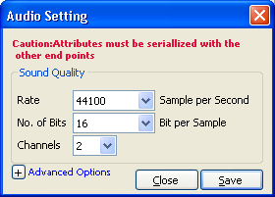
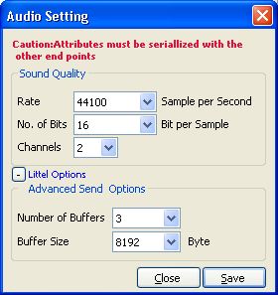
Audio Customization Cont.

Slide 25
Code for audio exchange
Audio exchange tools and classes:
    AudioReceiver.cs
    AudioSender.cs
    FifoStream.cs
    WaveNative.cs

Slide 26
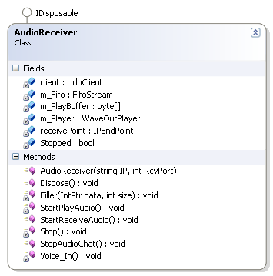
AudioReceiver
A class which is responsible for receiving audio streams from specific network port and play it on the speakers.

Slide 27
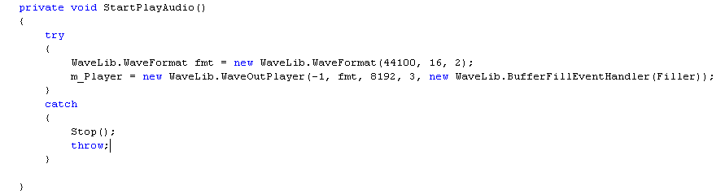
AudioReceiver Cont.

Slide 28
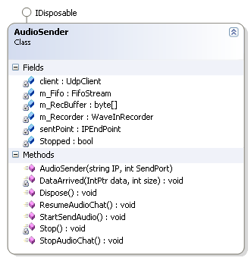
AudioSender
A class which is responsible for Capturing audio streams and sending it to specific predefined network port.

Slide 29
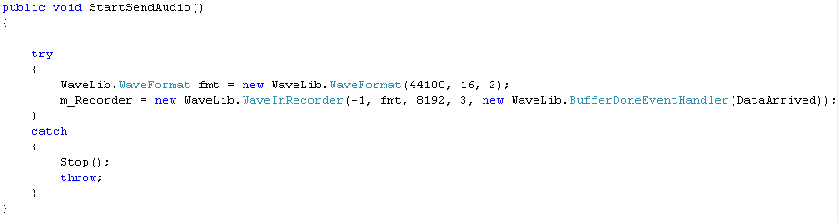
AudioSender Cont.

Slide 30
FifoStream
Memory stream inherited from Stream used to send and play audio bytes Buffer by buffer by reading and writing on it in First in first out fashion.
It acts as bottleneck as it’s used in both sending &receiving ,reading&writing.
Network ->FIFO Stream -> Read bytes array-> Create Header and format -> Speakers
Microphone -> remove Header and format -> write bytes array -> FIFO Stream ->Network

Slide 31
WaveNative.cs
Contains native API Audio classes and constants imported and Recreated, from the “Winmm.lib” library file.
It contains
    Class “WaveFormat”
    Structure “WaveHdr”

Slide 32
Video Exchange
The main reason for video exchange is video conference between a single server and several clients ”Broadcasting&Multicasting” so it’s
  Server initiated
  Half-Duplex from server to Clients only.

Slide 33
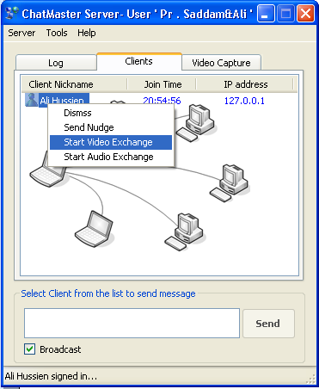
Initiating Video transmission
Select client and press …

Slide 34
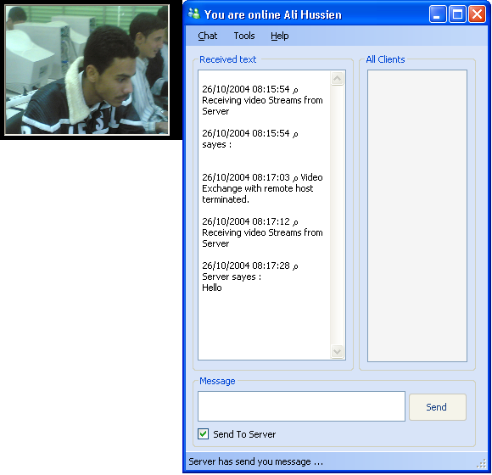
What happen in the remote side
Client can see this window by select “tools >Eject video preview”.
We detect this by reading client log.
Clicking it →insert.
Docked form for displaying video

Slide 35
Code
Steps
  Server Side
  Capture video at server from camera (discussed later).
  Display it to the picture box in the localhost.
  Sending frames to remote host(s).
  Client(s) Side
  Receive frame .
  Display it.
  Back to step 1

Slide 36

Capturing video
Open Preview window in picturebox.

Slide 37
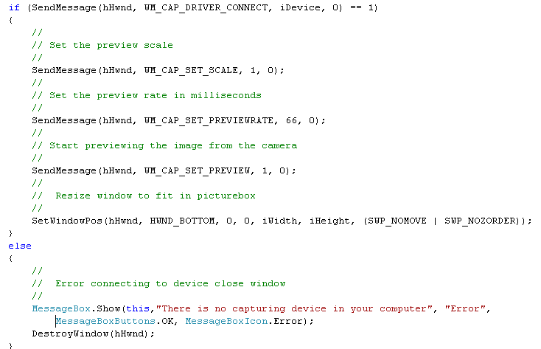
Capturing video cont.
Connect to camera

Slide 38
Project usages
Chatting,
conferencing

Slide 39
References
MS MSDN 2005.
e-Book:
  Digital.Press.Network.programming.in.dot.NET.C.Sharp.and.Visual.Basic.dot.NET.May.2004.eBook-DDU
  By
    Fiach Reid.

Slide 40
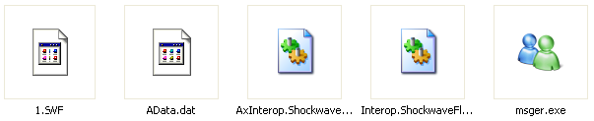
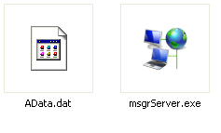
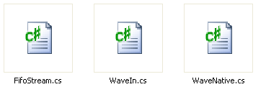
Uploaded files

Slide 41
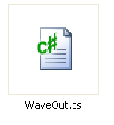
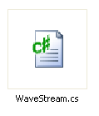
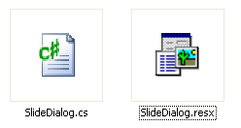
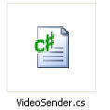
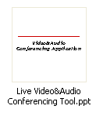
Uploaded files Cont.

Slide 42
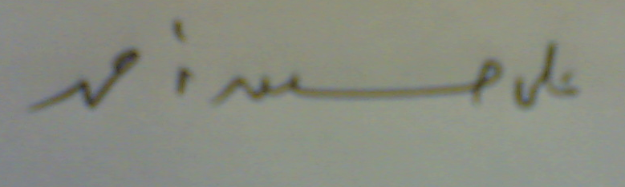
End of presentation
Thanks for All
Friday , 26-10-2007 9:27 pm

